Slide 1




Open access Open data Open software Open science
@micaelamatta
micaela.matta@kcl.ac.uk
Dr Micaela Matta
Lecturer in Computational Chemistry
King’s College London

Slide 2
Open access

Slide 3


Oct 24-30, 2022
https://github.com/OpenScienceMOOC

Slide 4
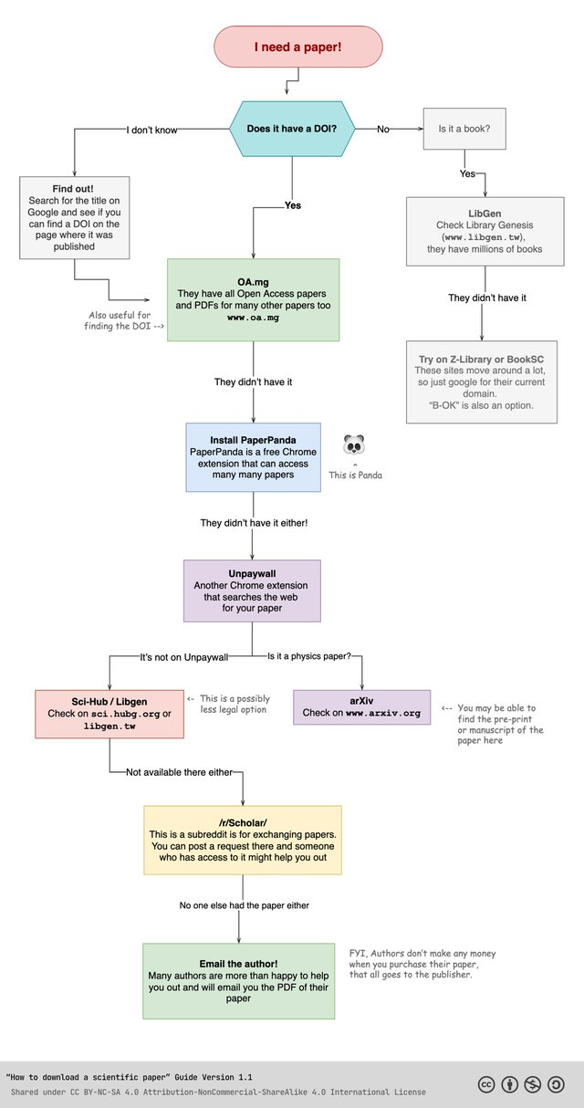
Paper access flowchart

Slide 5
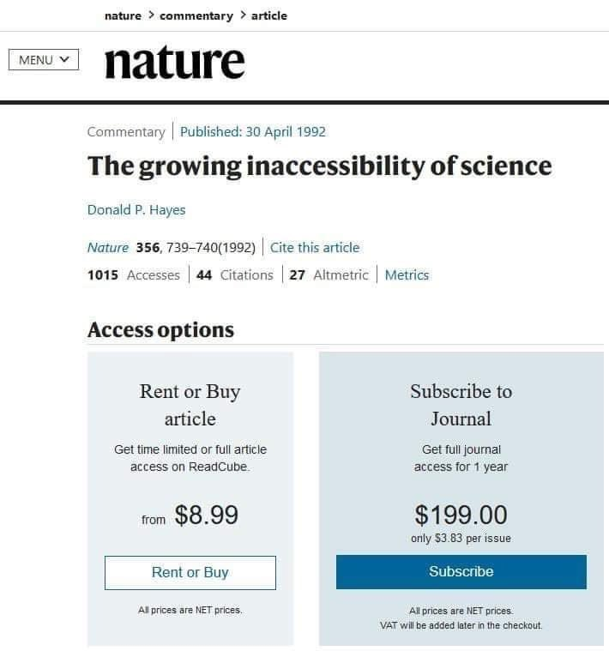
Notes:
https://axial.acs.org/2019/09/18/what-is-peer-review/

Slide 6
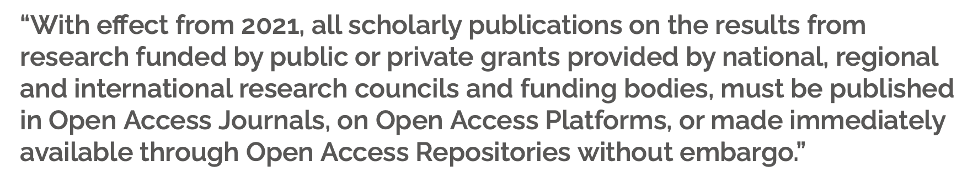


Plan S and other initiatives

Slide 7
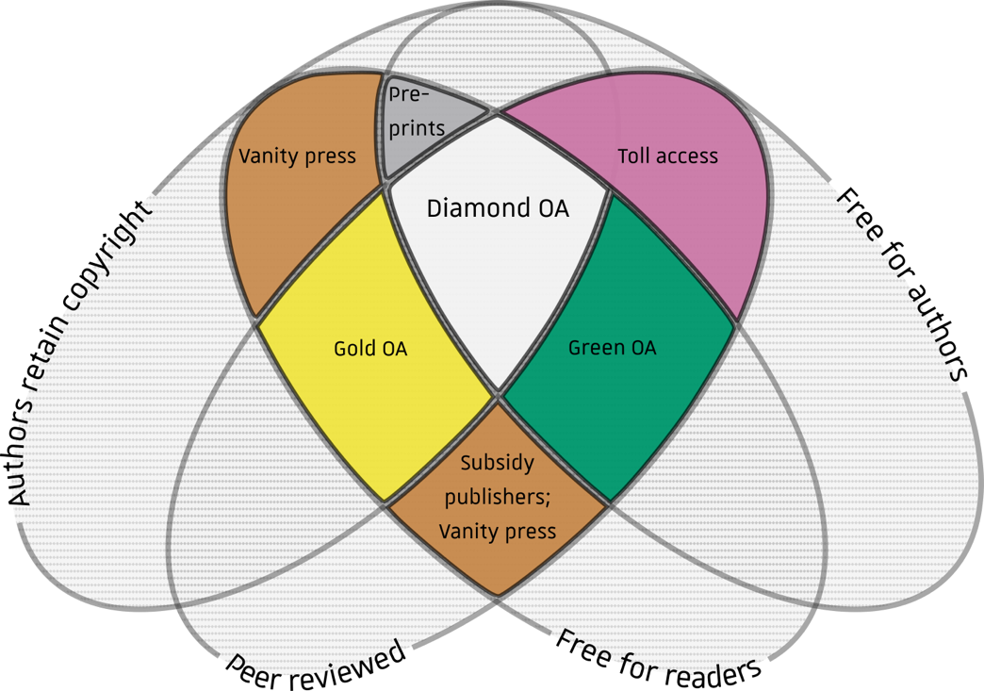
Publishing models and open access options
https://en.wikipedia.org/wiki/Diamond_open_access

Slide 8
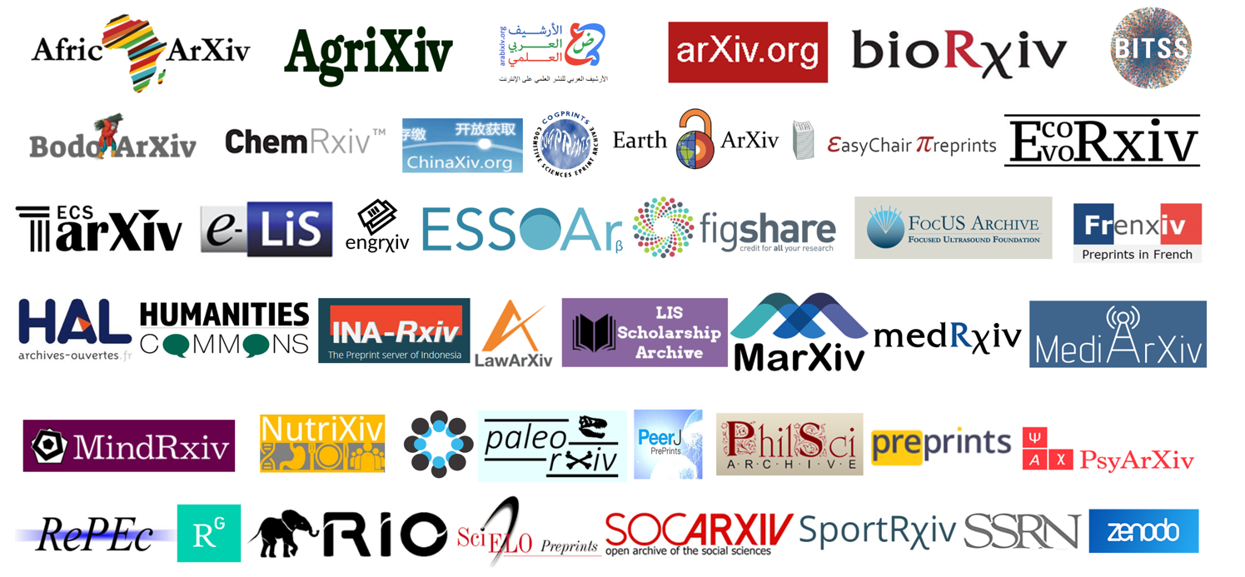
Preprint servers

Slide 9
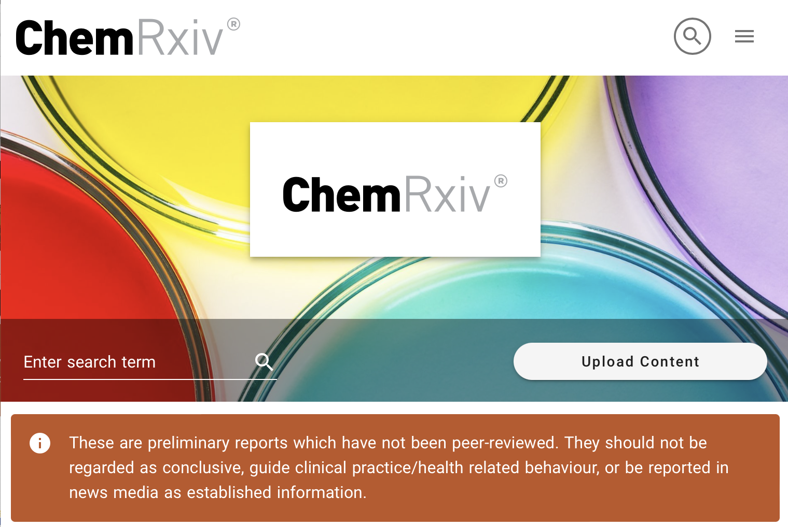
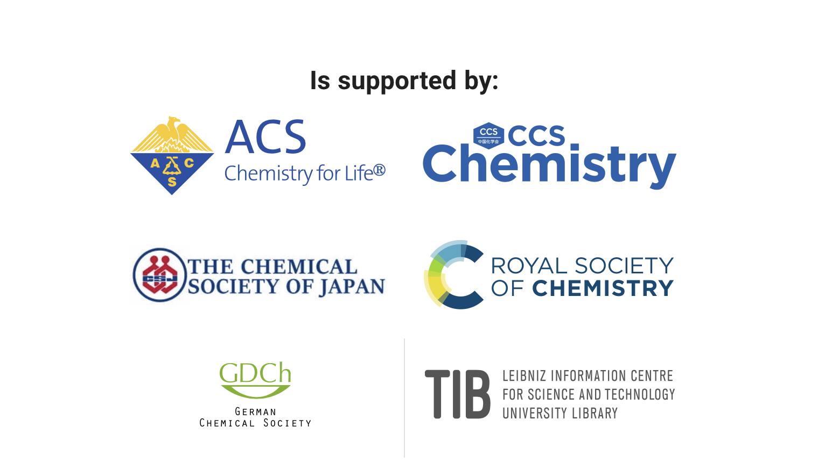

Slide 10
Positive aspects of preprints
Rapid dissemination to a wider audience
Immediate visibility of research and facilitate networking
Demonstration of research progress, particularly for early-career researchers
Availability for wider feedback/review from the research community
Establishment of precedence or intellectual priority
Potential citation advantage due to earlier and wider availability of research
Publishing Open Access even with limited or no funds
Performing corrections via revised versions
Publishing of all research findings and conditions, including negative results
Notes:
https://www.science.org/content/article/you-ve-spotted-flaw-top-journal-s-paper-good-luck-getting-your-critique-published

Slide 11
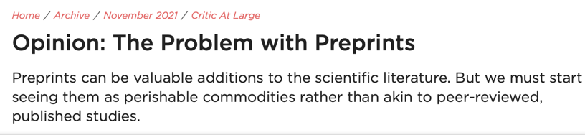
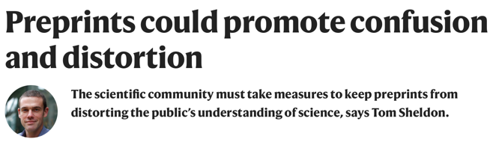
Against preprinting
Preprints give authors incentives to skip the scrutiny of peer review
Flood of publications of low quality
Risk of being scooped before peer review
Risk of weak studies receiving disproportionate attention, reporting of unverified data by the lay media

Slide 12
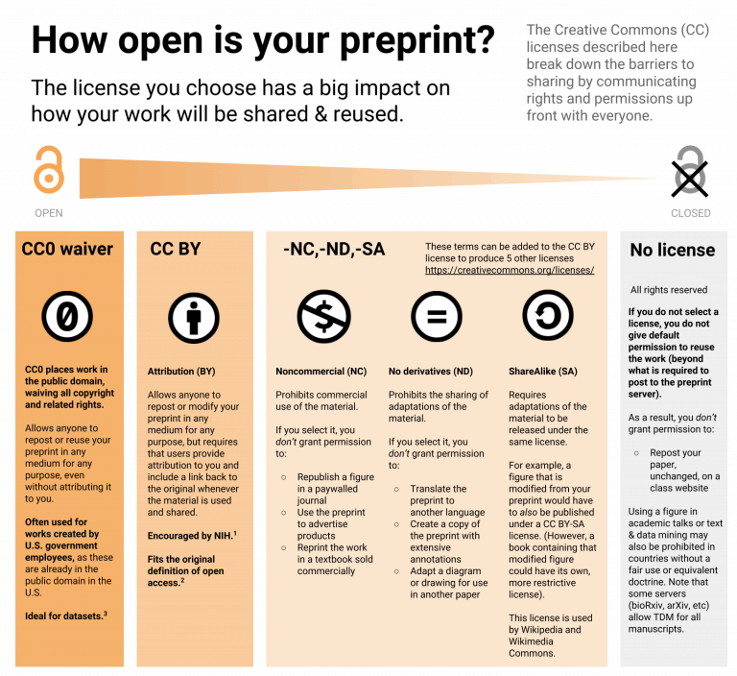
https://asapbio.org/new-licensing-resources

Slide 13


Cost of Open Access
€9,500, US$11,390 or £8,290 for Nature journals
$5,900 for Cell
£4290/$5890/€4890 for Nature communications (original OA journal from Nature Springer)
$3,500 - $4,500 for ACS Au journals
New Nature ‘guided open access’ scheme: €2,190 non-refundable fees to “cover editorial assessment and peer-review process”, simultaneous consideration at lower tier Nature journals
https://www.nature.com/articles/d41586-021-00271-0

Slide 14

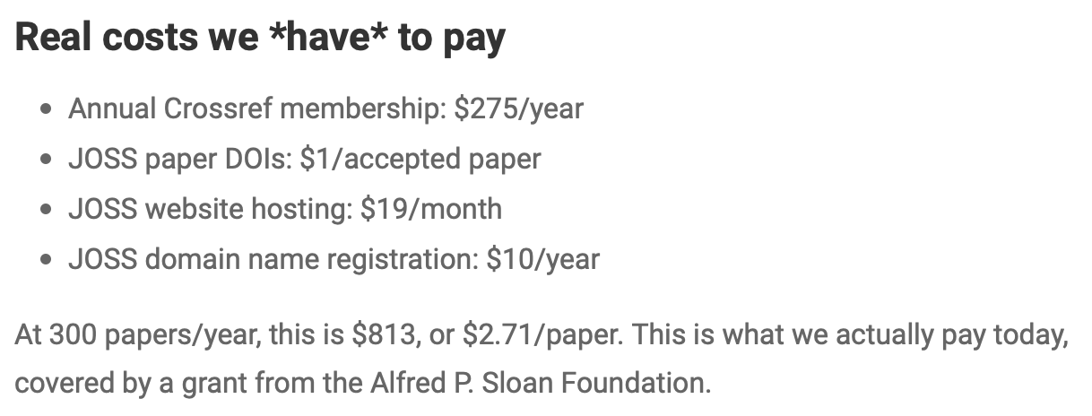
Cost of Open Access
The Journal of Open Source Software (JOSS) costs about $2.71 per article.
https://blog.joss.theoj.org/2019/06/cost-models-for-running-an-online-open-journal

Slide 15

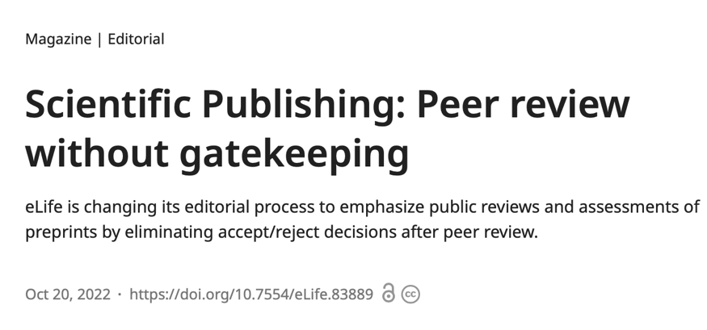
Latest controversy: eLife gets rid of rejections post peer-review
$3,000*
publishing fee 👀
*they offer discounts
Authors should be able to share their work freely and openly when they think it is ready.
01
Peer review should consist of scientists publicly sharing their assessments of already published papers, either under […] an editorial organization[…], or on their own.
02
Works of science should be reviewed by multiple relevant groups and individuals throughout their useful lifespan.
03

Slide 16
Should a financial incentive even be a thing?
Peer reviewers don’t receive any compensation.

Slide 17
Predatory Open Access Journals/Publishers
Little or no peer review or quality control, resulting in hoax and nonsensical papers.
Notifying academics of article fees only after papers are accepted.
Aggressively campaigning for academics to submit articles or serve on editorial boards.
Listing academics as members of editorial boards without their permission
Not allowing academics to resign from editorial boards
Appointing fake academics to editorial boards.
Mimicking name or web site style of more established journals.
Making misleading claims about the publishing operation, such as a false location.
Fake or non-existent impact factors.
https://en.wikipedia.org/wiki/Predatory_publishing
https://beallslist.net
https://guides.umd.umich.edu/c.php?g=813057&p=5801511

Slide 18
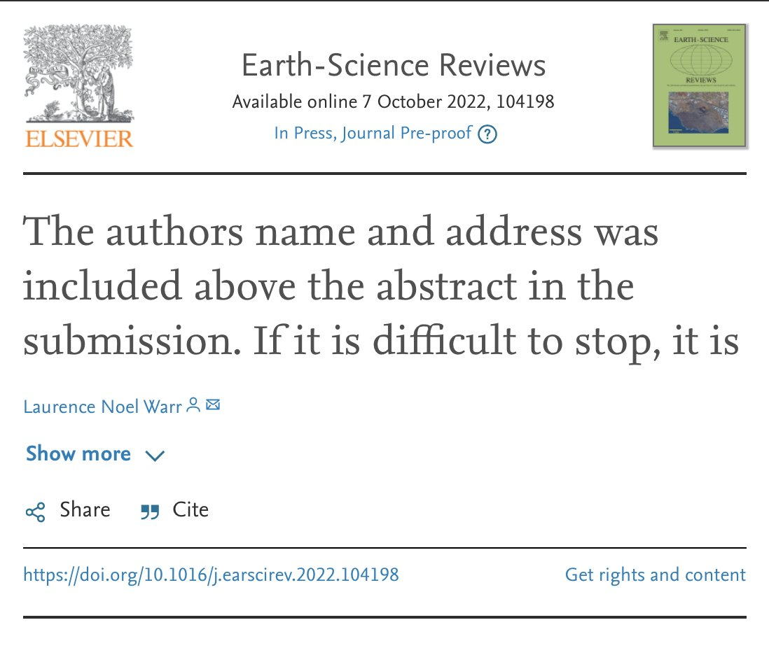
https://en.wikipedia.org/wiki/Predatory_publishing
https://beallslist.net
https://guides.umd.umich.edu/c.php?g=813057&p=5801511

Slide 19
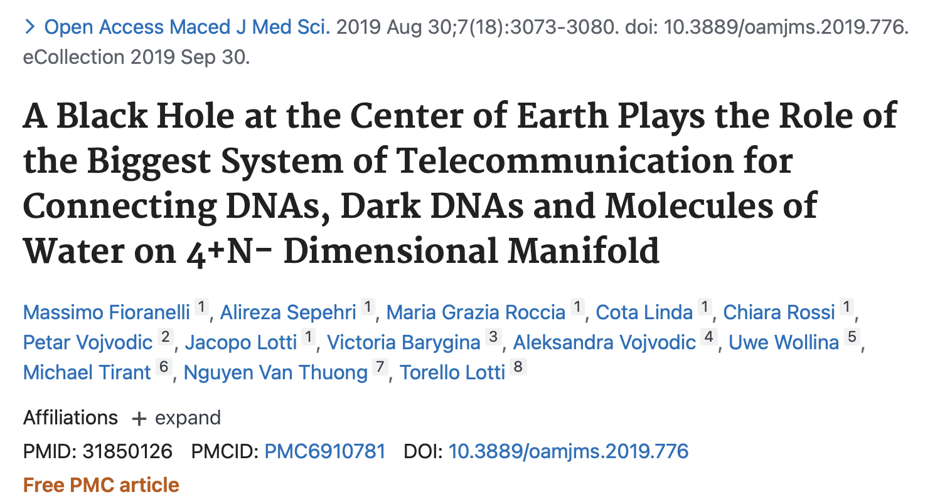
Retraction notice: ”An internal investigation has raised sufficient evidence that they are not directly connected with the special issue Global Dermatology and contain inconsistent results”

Slide 20
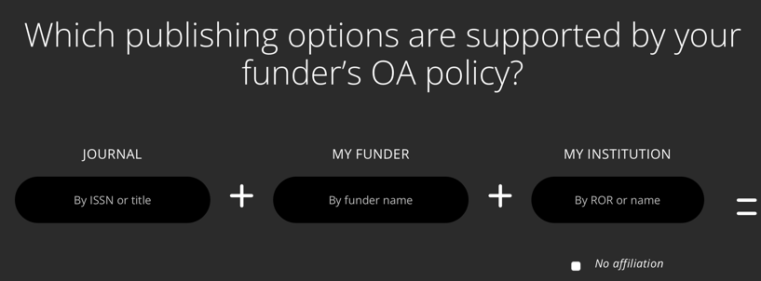
Resources
https://journalcheckertool.org
https://www.ukri.org/news/open-access-policy-update-july-2022/
https://github.com/OpenScienceMOOC

Slide 21
Open data

Slide 22

FAIR principles
Findability
Accessibility
Interoperability
Reuse of digital assets
FAIR emphasise machine-actionability (i.e., the capacity of computational systems to find, access, interoperate, and reuse data with none or minimal human intervention
https://www.go-fair.org/fair-principles

Slide 23
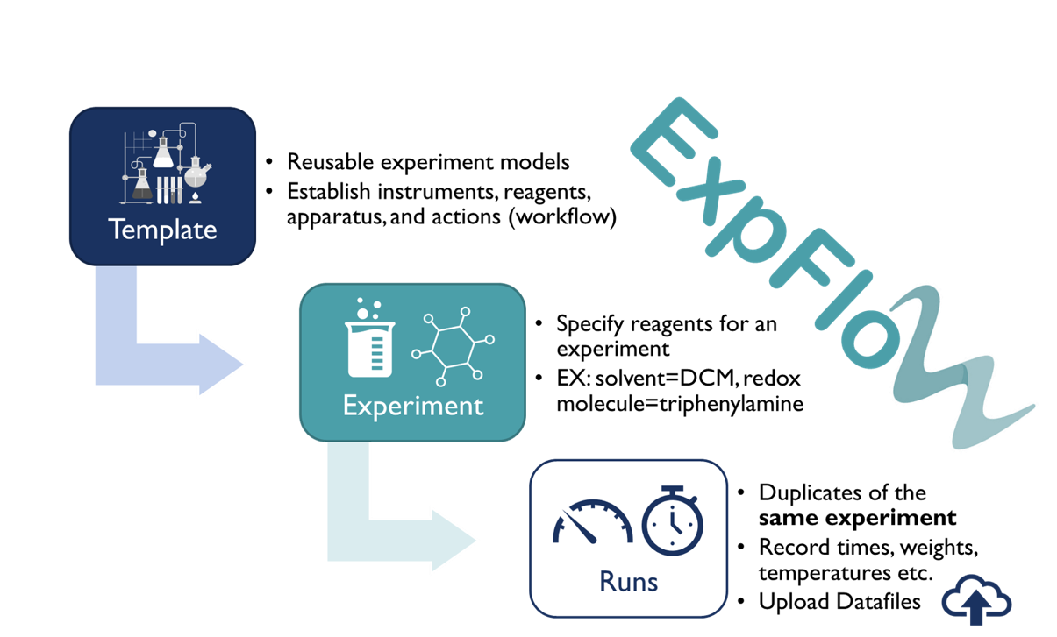
Data and metadata for experimental chemistry
https://knowledgebase.nfdi4chem.de/knowledge_base/
https://d3tales.as.uky.edu/expflow/

Slide 24
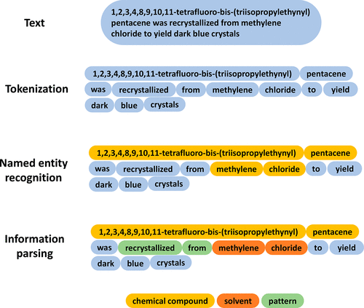
Data and metadata for experimental chemistry
https://knowledgebase.nfdi4chem.de/knowledge_base/
Chem. Mater. 2022, 34, 11, 4821–4827

Slide 25
Open software

Slide 26
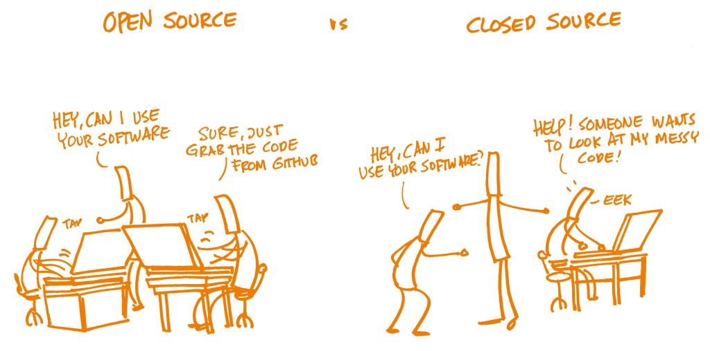
Open Source Software (OSS)
Often, OSS is developed in a public, decentralised, collaborative manner between multiple contributors.

Slide 27
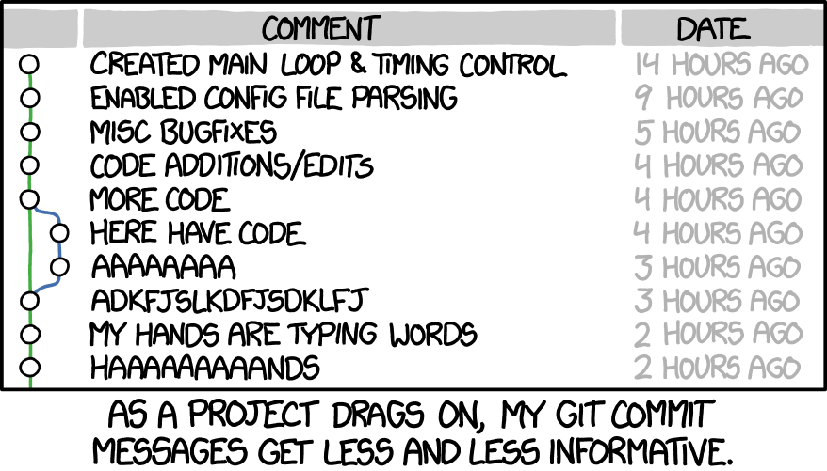


Version control
https://github.com/
xkcd

Slide 28

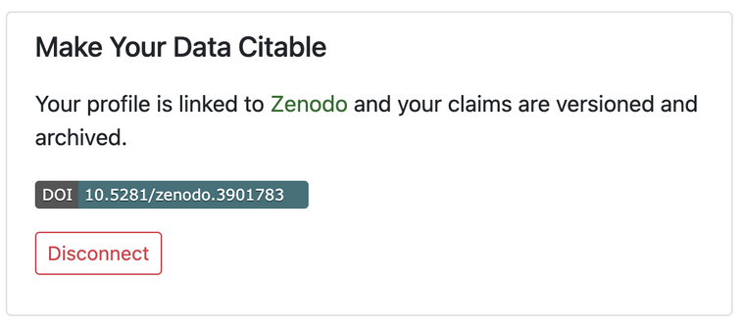
1. Use version control with git/GitHub 2. Put a DOI on it with Zenodo
https://github.com/
https://zenodo.org

Slide 29
10 simple rules for reproducible (computational) research
For every result, keep track of how it was produced.
Avoid manual data manipulation steps.
Archive the exact versions of all external programs used.
Version control all custom scripts.
Record all intermediate results, when possible in standardised formats.
For analyses that include randomness, note underlying random seeds.
Always store raw data behind plots.
Generate hierarchical analysis output, allowing layers of increasing detail to be inspected.
Connect textual statements to underlying results.
Provide public access to scripts, runs, and results.
Sandve et al., (2013)
https://github.com/OpenScienceMOOC

Slide 30
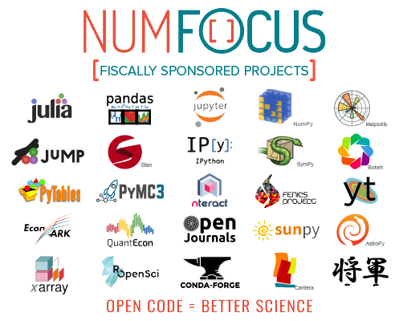

What powers NASA research? Python, R, Julia..
disclosure: I receive funding from NumFOCUS through MDAnalysis

Slide 31
Open science

Slide 32

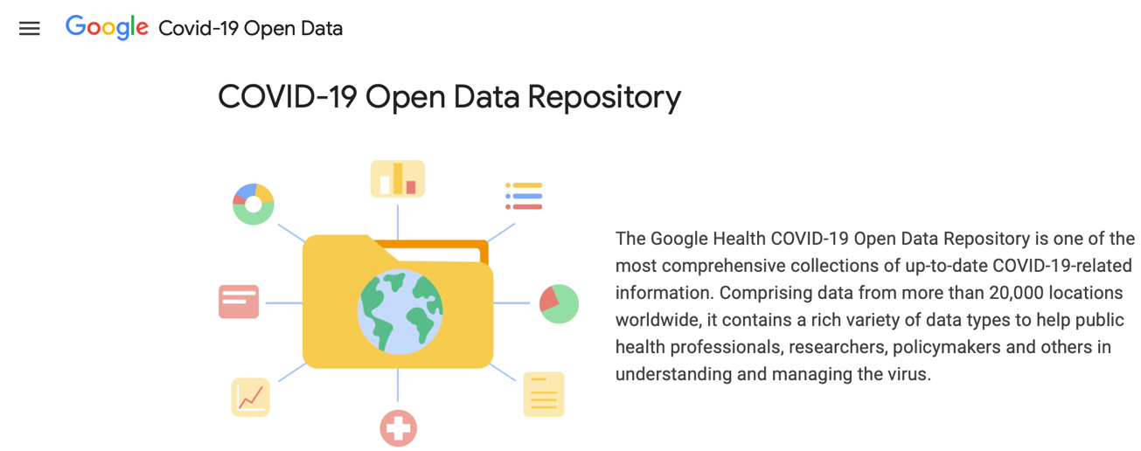

Slide 33
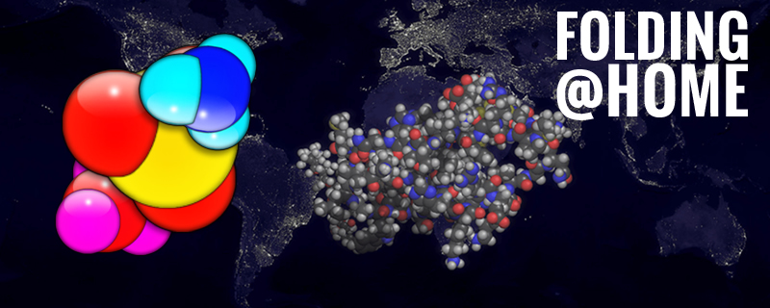

Community science is open science
https://en.wikipedia.org/wiki/Folding@home
https://foldingathome.org/

Slide 34
Open to questions!
@micaelamatta
micaela.matta@kcl.ac.uk
Dr Micaela Matta
Lecturer in Computational Chemistry
King’s College London

